Slide 1
Prevention of sandalwood trees using IOT
Project Members :-
Sahil Subudhi (Reg.no – 200301131010)
Sachidananda Panda(Reg.no – 200301130002)
Shreya Mishra(Reg.no – 200301131012)
Guided By :-
Mrs. Swarnaprabha Jena (Asst. Prof)
Mr. Subrat Kumar Pradhan (Asst. Prof)

Slide 2
outline
Introduction
Hardware Required
Software Required
Block Diagram
Circuit Diagram
PCB Designing
Working Model
Webserver Outcome
Future Enhancement

Slide 3
introduction
According to report, an estimate of 100-150 sandalwood trees are being lost in just Karnataka by uncertain means which counts a huge loss in crores of Indian rupees
This project uses Internet of Things (IOT) as a solution to the problem of theft of sandalwood trees using present day technologies and also upcoming technologies.
The main project behind this is to develop an system which can detect any illegal activity and issue a warning to alert the forest officials which reduce the risk natural damage.

Slide 4
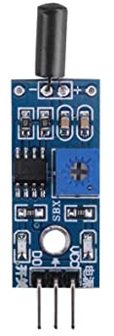
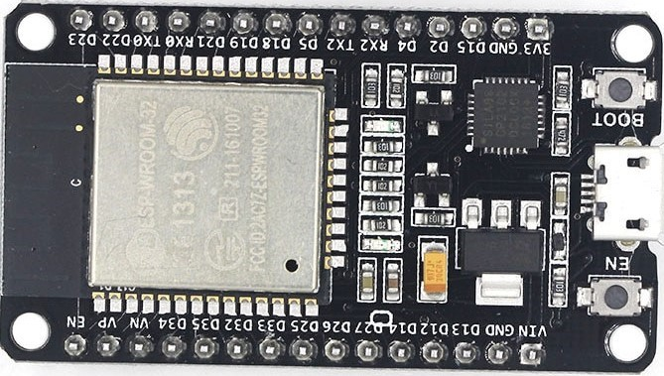
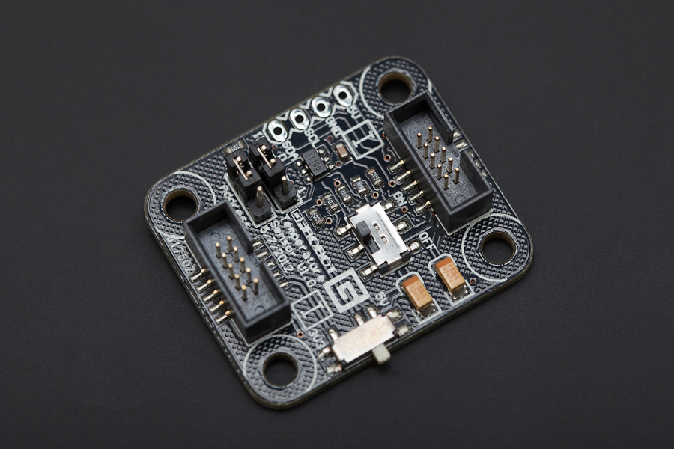
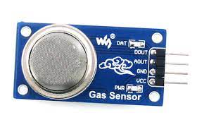
Hardware
ESP 32
SMOKE SENSOR
(MQ-02)
TEMPERATURE SENSOR(TMP100)
VIBRATION SENSOR(SW18015P)

Slide 5
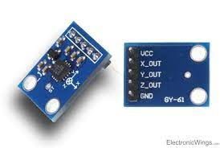
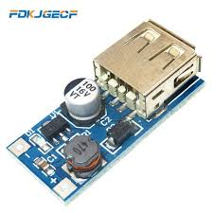

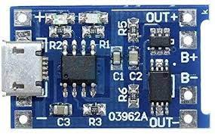
HARDWARE
ACCLEROMETER
(ADXL335)
BOOST CONTROLLER
Lithium battery CHARGING KIT(TP4056)
COPPER CLAD

Slide 6
software
Arduino IDE
EAGLE

Slide 7
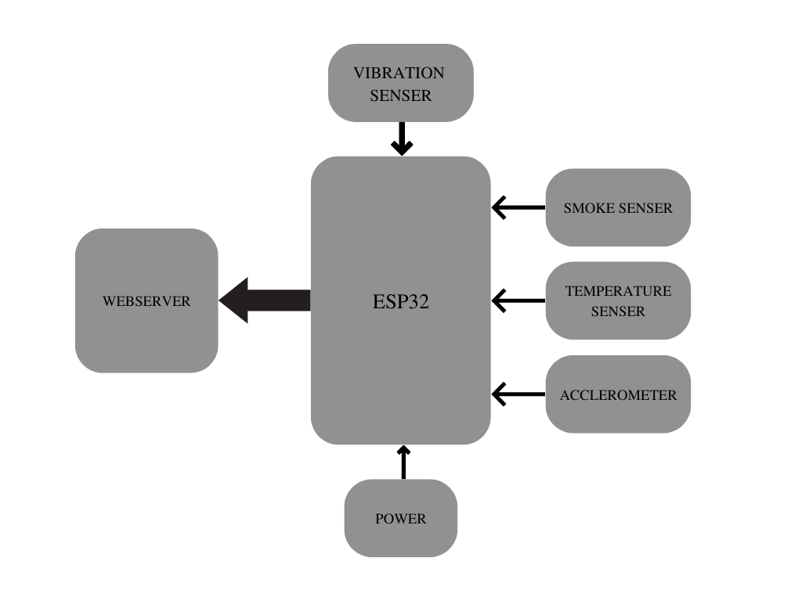

BLOCK DIAGRAM

Slide 8
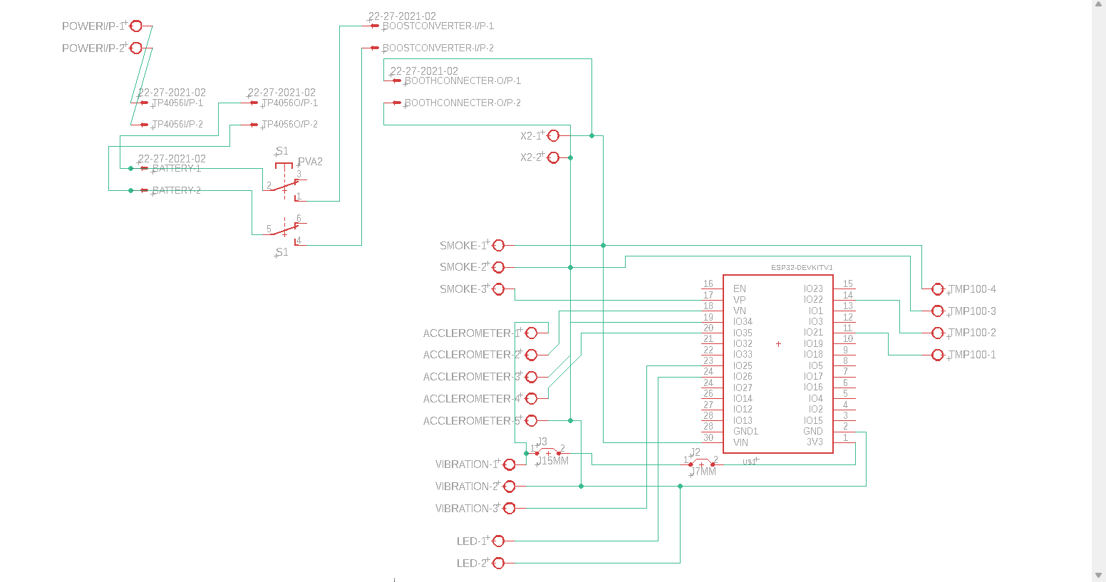
Circuit Diagram

Slide 9
PCB Designing

Slide 10
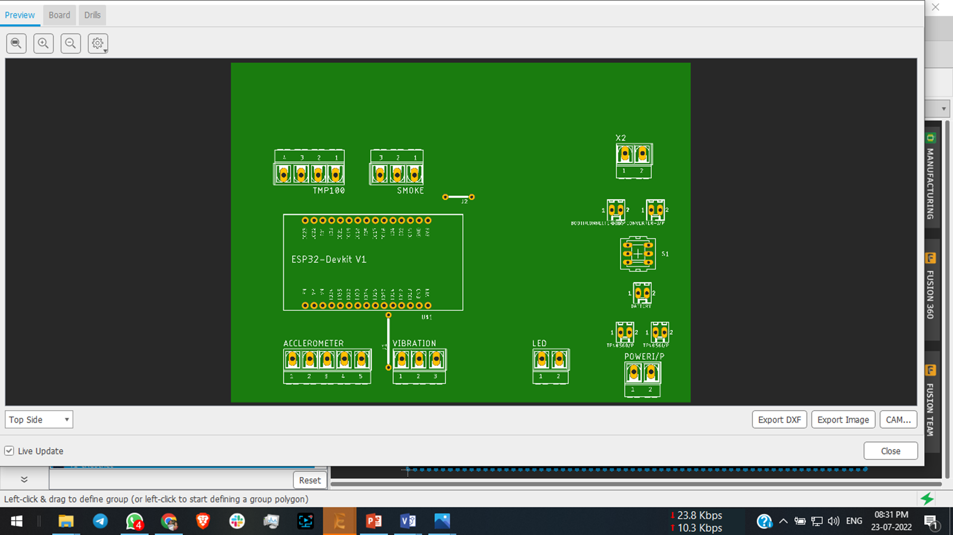
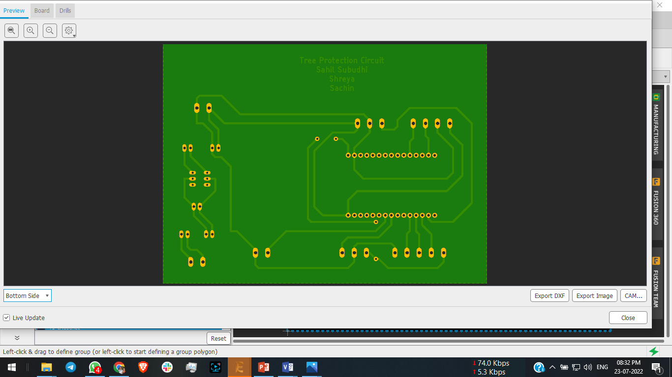
Top view of PCB Board
Bottom view of PCB Board

Slide 11
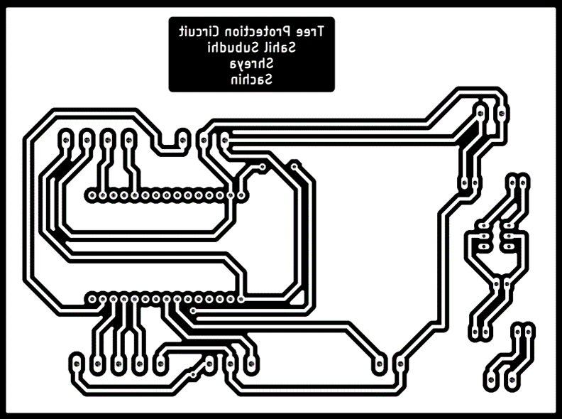
procedure

Slide 12
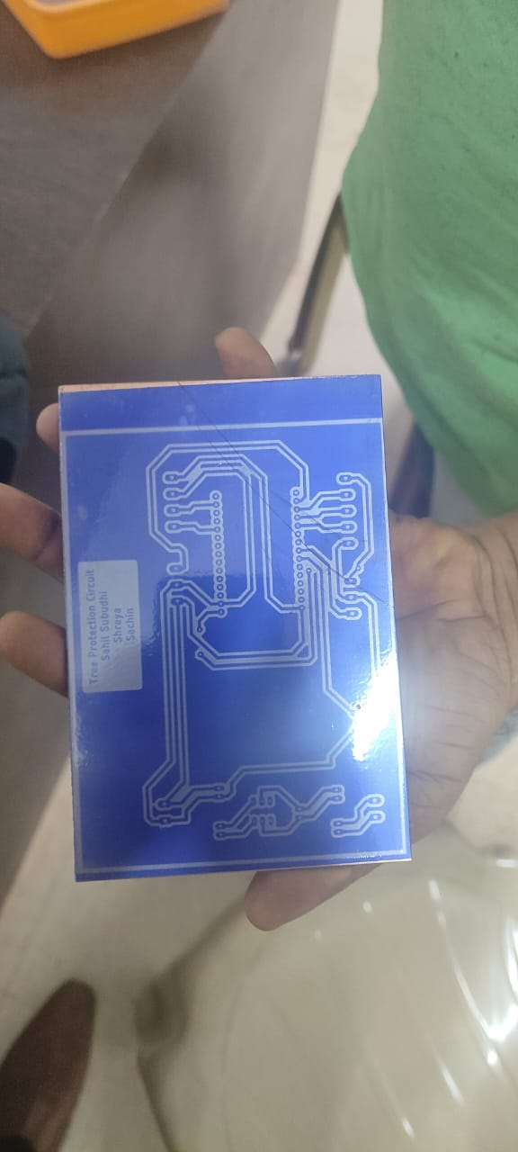
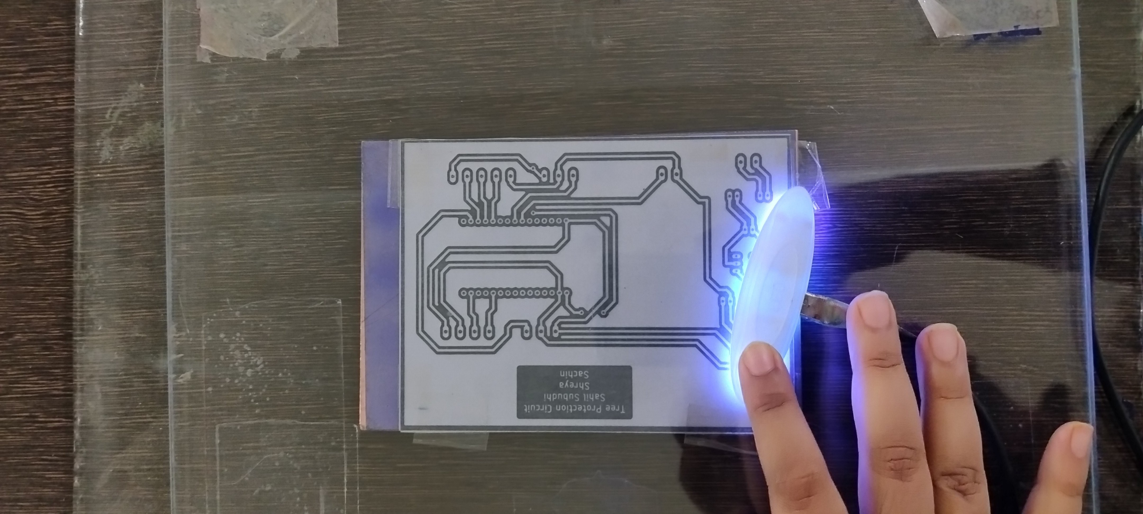
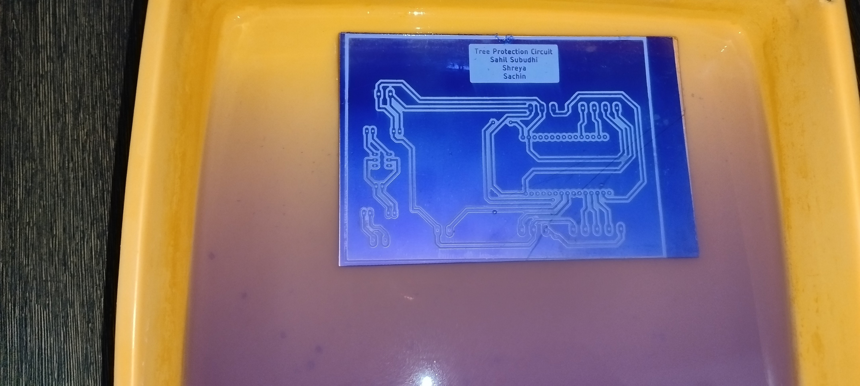
procedure

Slide 13
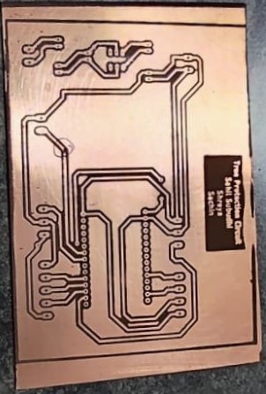
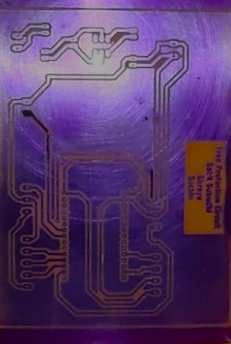
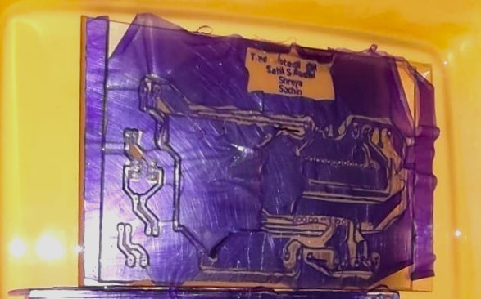
procedure

Slide 15
Working setup

Slide 16
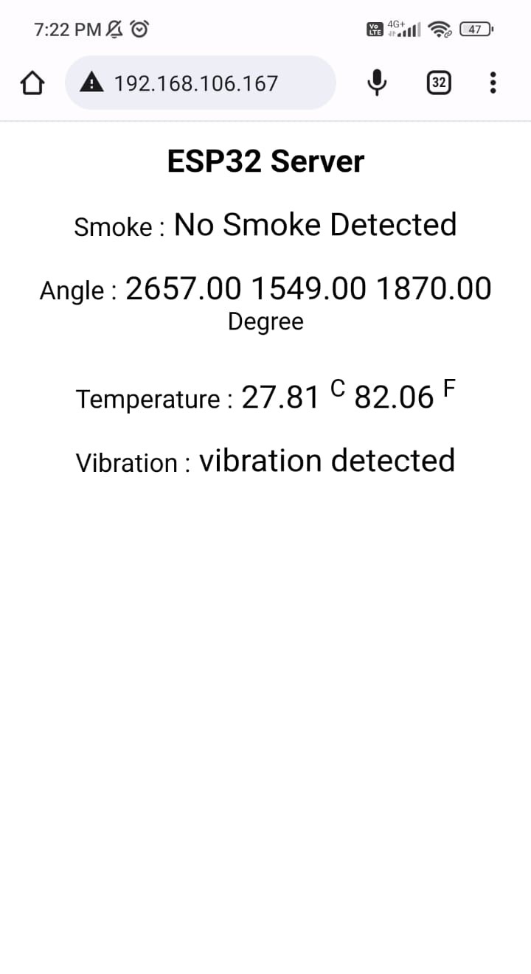
webserver

Slide 17
Future enhancement
Further we can use GSM Module for global access.
We can also camera module.
We can modify the code of accelerometer to get exact change in motion.

Slide 18
references
https://www.ijeat.org/wp-content/uploads/papers/v8i5S/E10070585S19.pdf

